Slide 1
Artificial Intelligence Blockchain Based Fake News Discrimination

Slide 2
Abstract
The project aims to minimize the impact of fake news using blockchain and artificial intelligence technologies, while also verifying the authenticity of news through blockchain.
Blockchain provides secure, tamper-proof storage for news articles, ensuring data integrity.
The project focus is to use AI algorithms including ANN, CBR, and LSTM , that predicts the future spread of fake news, enhancing the understanding of how misinformation propagates.
Smart Contracts, designed using Solidity programming, facilitate the secure storage and retrieval of news data on the Blockchain.
As an extension advanced AI techniques like Bi-directional GRU and XGBOOST are employed to enhance the accuracy of fake news detection.

Slide 3
Introduction
Fake news has become a significant issue in the digital age, affecting public perception and trust across various media platforms, leading to widespread misinformation.
The rapid advancement of digital media and technology has facilitated the swift spread of false information, complicating the landscape of information dissemination.
Traditional verification methods have proven inadequate in combating the evolving tactics of misinformation, necessitating innovative approaches to address the fake news crisis.
Blockchain technology offers a robust solution for enhancing trust and transparency in news reporting, while artificial intelligence provides powerful tools for detecting and classifying fake news.

Slide 4
Problem Statement
The rise of fake news poses a significant threat, eroding public trust in media and leading to serious societal consequences.
Fake news incurs substantial economic and social costs, emphasizing the urgent need for effective detection and mitigation strategies.
Current methods for identifying fake news often lack the technological sophistication necessary to keep up with evolving misinformation tactics.
Blockchain-based news platforms struggle to gain consumer trust and market acceptance, questioning their effectiveness in combating fake news.
There is a pressing need for integrated solutions that combine artificial intelligence and blockchain technology to enhance news verification and predict the spread of fake news.

Slide 5
Objective
The objective is to establish a secure Blockchain-based system for the immutable storage of news articles, preventing unauthorized modifications and ensuring data integrity.
The goal is to leverage advanced Artificial Intelligence algorithms to analyze and classify news articles, determining their authenticity and identifying fake content effectively.
The objective is to develop a streamlined user interface that allows news publishers and subscribers to easily access, upload, and verify news content, fostering transparency and user engagement.
The goal is to assess the impact of the proposed solution on public trust in news media by evaluating the performance to measure the system’s effectiveness in mitigating the spread of fake news.

Slide 6
Existing System
The existing system for managing news content relies on centralized platforms, where traditional media organizations store, publish, and verify news articles. These platforms typically use manual verification processes, depending on journalists and fact-checkers to assess the authenticity of information. Although some have started incorporating automated tools for content analysis, they still struggle to effectively combat the spread of misinformation.
Disadvantages Of The Existing System
Centralized systems are prone to unauthorized modifications, allowing false information to spread without accountability.
Manual verification processes are time-consuming, leading to delays in addressing fake news and enabling rapid misinformation dissemination.
Existing systems often lack transparency in their verification processes, resulting in decreased user trust in the authenticity of news articles.

Slide 7
Proposed System
The proposed system integrates Blockchain technology and Artificial Intelligence to securely manage news content. Blockchain is a decentralized digital ledger technology that securely records transactions across multiple nodes, grouping them into cryptographically linked blocks to form an immutable chain. Advanced AI algorithms, including ANN, LSTM, and CBR, classify articles as real or fake and predict the spread of misinformation. Smart Contracts facilitate secure storage and retrieval of news data, enhancing system reliability.
Advantages Of The Proposed System
Blockchain technology ensures secure, tamper-proof storage of news articles, preventing unauthorized modifications and maintaining data integrity.
AI algorithms automate the detection and classification of fake news, reducing the time and resources needed for manual verification and enabling faster identification of misinformation.
The decentralized nature of the system allows users to verify the authenticity of articles easily, fostering greater trust in news content and media organizations.
SHA256 hash codes provide unique fingerprints for news articles, allowing easy detection of alterations and enhancing user trust in the information.

Slide 8
Extension / Novelty
The extension of the project involves incorporating advanced Artificial Intelligence techniques, such as Bi- directional GRU (Gated Recurrent Unit) and XGBOOST, to enhance the accuracy of fake news detection. These algorithms improve the system's ability to analyze complex patterns in news content and user behavior, leading to more reliable classifications of articles as real or fake. Additionally, Ganache and MetaMask are employed to enhance the Ethereum blockchain integration, providing a secure, efficient, and user-friendly environment for managing transactions and validating data integrity within the system.

Slide 9
Advantages of Extension / Novelty
The use of Bi-directional GRU and XGBOOST improves the precision of fake news detection by analyzing data from multiple perspectives and leveraging ensemble learning techniques, resulting in more accurate classifications.
Advanced algorithms like Bi-directional GRU can capture intricate patterns in data over time, enhancing the system's ability to understand contextual information and the nuances of language used in news articles.
Incorporating XGBOOST, known for its efficiency and performance, enhances the system's robustness against various types of misinformation, making it more adaptable to evolving fake news tactics and trends.
Ganache provides a local Ethereum blockchain environment, enabling efficient testing and deployment of smart contracts without relying on the main network, ensuring secure and optimized performance for fake news verification.
MetaMask acts as a secure Ethereum wallet, safeguarding private keys and facilitating easy interaction with the decentralized application (DApp), ensuring reliable and user-friendly access to the fake news detection system.

Slide 10
Literature Survey
TITLE | AUTHOR | METHODOLOGY | PROPOSED SYSTEM | CONS | CONCLUSION
Fake news detection based on news content and social contexts: a transformer-based approach | Raza, S., Ding, C. Link: https://doi.org/10.1007/s41060-021-00302-z | The methodology involves collecting real-world data, applying the proposed model to exploit information from news articles and social contexts, and using an effective labeling technique to mitigate the issue of label scarcity. Experimental evaluations are conducted to compare the model's performance with baseline methods. | The proposed framework utilizes a Transformer architecture, consisting of an encoder to learn representations from fake news data and a decoder to predict future behavior based on past observations. This approach integrates various features from news content and social contexts to enhance classification accuracy. | potential vulnerability of the stored data to unauthorized access, which could compromise the integrity of the news content. Additionally, the reliance on a centralized system for data storage may pose risks in terms of data availability and resilience against attacks. | : The proposed fake news detection framework demonstrates the potential for early detection with high accuracy, addressing critical challenges in the field. The incorporation of both news content and social context features significantly enhances the model's capability to identify misinformation effectively.

Slide 11
Literature Survey
TITLE | AUTHOR | METHODOLOGY | PROPOSED SYSTEM | CONS | CONCLUSION
Unsupervised Fake News Detection on Social Media: A Generative Approach | Yang, S., Shu, K., Wang, S., Gu, R., Wu, F., & Liu, H. Link: https://ojs.aaai.org/index.php/AAAI/article/view/4508 | The methodology involves treating the truths of news and users' credibility as latent random variables, leveraging a collapsed Gibbs sampling approach to infer these truths without the need for labeled data. This approach allows for the effective modeling of conditional dependencies within the data. | The proposed system aims to detect fake news in an unsupervised manner by utilizing users' engagements on social media to assess the authenticity of news and the credibility of users. A Bayesian network model is employed to capture the relationships between news truths, user opinions, and user credibility. | As the volume of data on social media platforms increases, the Bayesian network model may face challenges in scalability and computational efficiency, potentially impacting its real-time performance in detecting fake news. | The proposed unsupervised method demonstrates a significant improvement in detecting fake news compared to existing unsupervised techniques, showcasing the potential of leveraging social media engagement data. Future work could focus on enhancing the model's accuracy and addressing the limitations associated with biased user engagement data.

Slide 12
Literature Survey
TITLE | AUTHOR | METHODOLOGY | PROPOSED SYSTEM | CONS | CONCLUSION
FANG: Leveraging Social Context for Fake News Detection Using Graph Representation | Nguyen, V., Sugiyama, K., Nakov, P., & Kan, M Link: https://arxiv.org/abs/2008.07939 | FANG utilizes a representation learning approach to capture social context, allowing it to create high-fidelity representations for improved fake news detection. The system is evaluated through experimental results that compare its performance against both graphical and non-graphical models, demonstrating its robustness with limited training data. | The proposed system, Factual News Graph (FANG), is a novel framework designed for fake news detection, emphasizing representation learning through a graphical social context representation. | FANG is reliant on the availability of high-quality social context data, which may not always be accessible. Additionally, while FANG shows promise in representation learning, it may require further refinement for optimal performance across diverse news sources and contexts. | FANG presents a significant advancement in fake news detection by effectively capturing social context through its graphical representation learning framework. Its ability to generalize learned representations to related tasks further emphasizes its potential in improving information reliability and combating misinformation.

Slide 13
Literature Survey
TITLE | AUTHOR | METHODOLOGY | PROPOSED SYSTEM | CONS | CONCLUSION
CSI: A Hybrid Deep Model for Fake News Detection | Ruchansky, Natali et al. Link: https://arxiv.org/abs/1703.06959 | The methodology involves three modules: Capture, which uses a Recurrent Neural Network to analyze user activity and text patterns; Score, which evaluates user behavior; and Integrate, which combines these elements to predict the authenticity of an article. | The proposed system combines text analysis, user response, and the behavior of users promoting the news to create a comprehensive model called CSI, which uses Recurrent Neural Networks to capture temporal patterns and integrates these with user behavior characteristics to classify news as fake or not. | The centralized storage and processing of large volumes of user data pose significant data security risks and create a single point of failure, making the system vulnerable to data breaches and unauthorized access. | The CSI model demonstrates a higher accuracy in fake news detection by incorporating user and article behaviors, suggesting that combining multiple characteristics provides a more robust approach to identifying misinformation.

Slide 14
Literature Survey
TITLE | AUTHOR | METHODOLOGY | PROPOSED SYSTEM | CONS | CONCLUSION
Early detection of fake news on social media through propagation path classification with recurrent and convolutional networks | Yang Liu and Yi-Fang Brook Wu Link: https://dl.acm.org/doi/abs/10.5555/3504035.3504079 | The methodology involves modeling the propagation path of each news story as a multivariate time series, with each tuple representing user characteristics, and then using a classifier that combines recurrent and convolutional networks to detect fake news by analyzing these propagation paths. | The proposed system leverages a combination of recurrent and convolutional networks to model news propagation paths as multivariate time series, capturing user characteristics to detect fake news early in its dissemination. | The high computational complexity of the model could hinder its scalability and real-time processing capabilities. | The proposed model enhances early detection of fake news on social media, achieving high accuracy rates on datasets from Twitter and Sina Weibo, and can identify fake news within minutes of its spread, outperforming current state-of-the-art methods.

Slide 15
Literature Review / Novelty
To address the limitations identified in the literature survey, the project employs blockchain technology for secure, tamper-proof storage of news articles, enhancing data integrity and authenticity verification. It implements advanced AI algorithms, including ANN, LSTM, Bi-directional GRU, and XGBOOST, to improve the accuracy of fake news detection. The use of SHA256 hash codes for fingerprinting news articles facilitates easy verification and detection of tampering. A user-friendly web interface ensures seamless access for publishers and subscribers, while comprehensive reporting features offer insights into AI performance, guiding future enhancements. These innovations aim to create a robust system for combating fake news and improving information reliability.

Slide 16
Requirements
Software Requirements
Python IDLE ( 3.7.0)
Node Js
Visual Studio Community Version
Ganache
MetaMask - Chrome Extension
Back-end Languages
Python
Java Script
Solidity
FrameWork
Django
Front-end Languages
HTML
CSS
JS
Bootstrap4
Hardware Requirements
Processor : i5 and above
RAM : 8GB and above
ROM : 20GB and above

Slide 17
FUNCTIONAL AND NON- FUNCTIONAL REQUIREMENTS
FUNCTIONAL
User Registration and Login
News Upload and Storage
Fake News Detection
News Retrieval
Performance Reporting
NON- FUNCTIONAL
Security
Usability
Scalability
Performance
Reliability

Slide 18
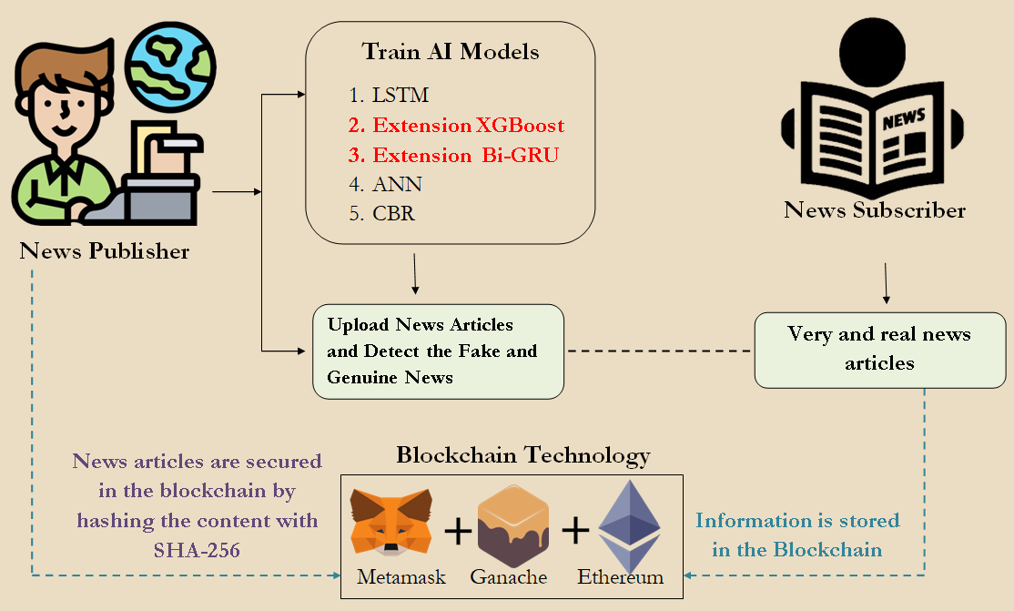
System Architecture

Slide 19
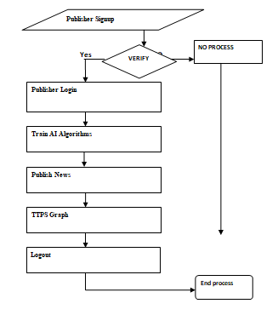
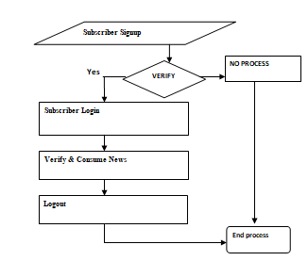
DATA FLOW DIAGRAM
PUBLISHER
SUBSCRIBER

Slide 20
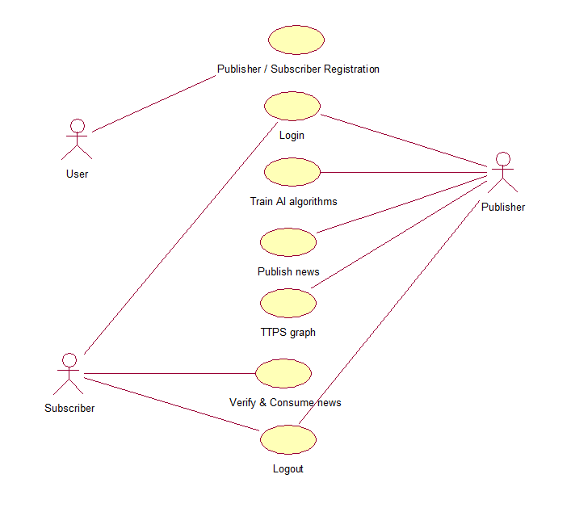
USE CASE DIAGRAM

Slide 21
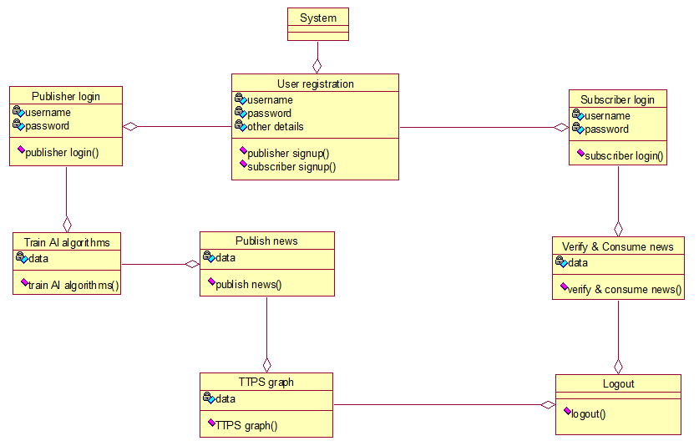
CLASS DIAGRAM

Slide 22
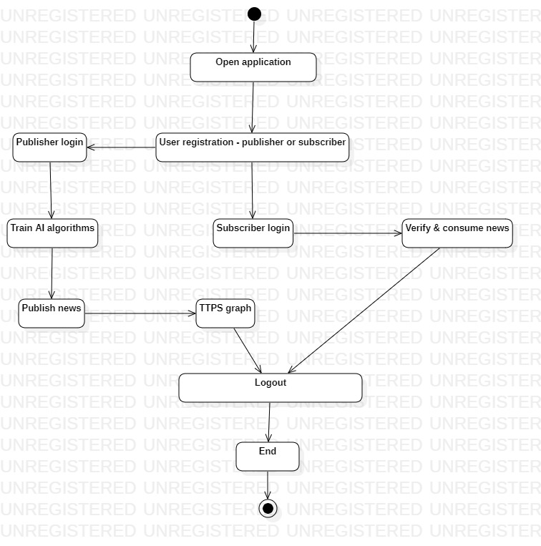
ACTIVITY DIAGRAM

Slide 23
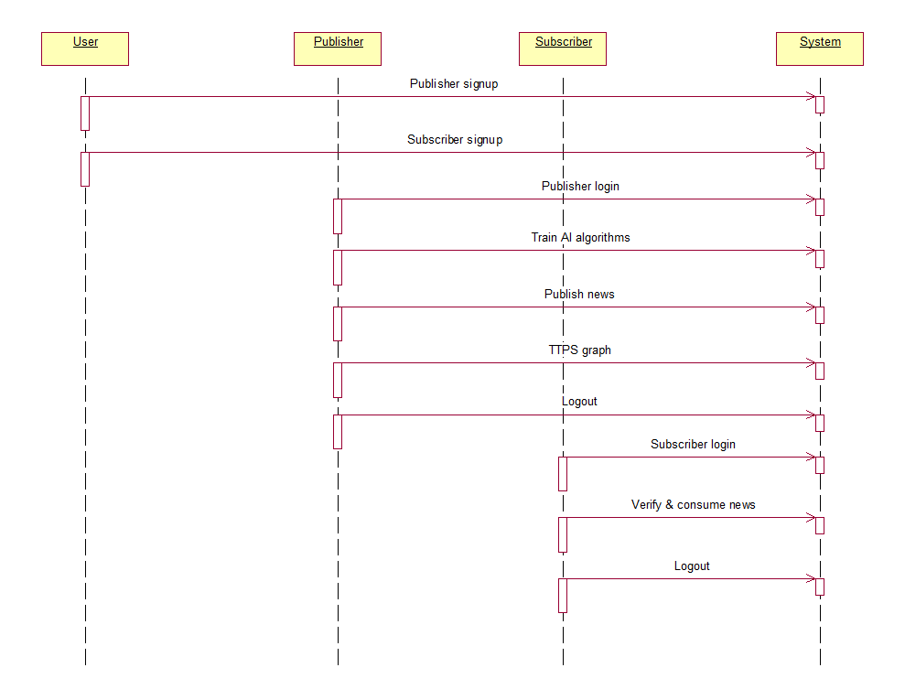
SEQUENCE DIAGRAM

Slide 24
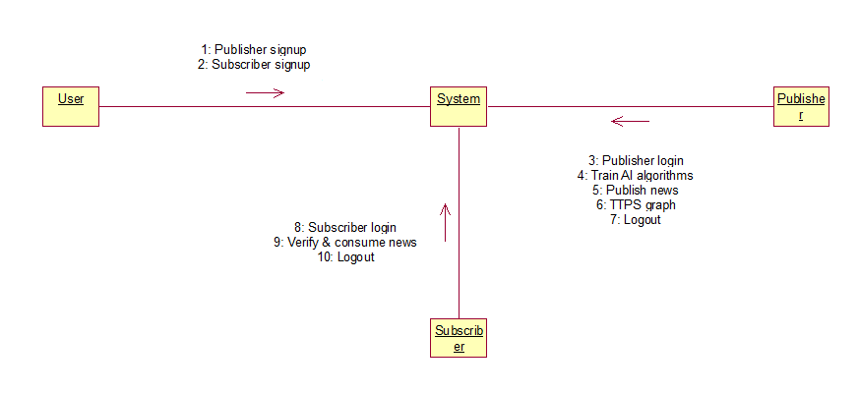
COLLABORATION DIAGRAM

Slide 25
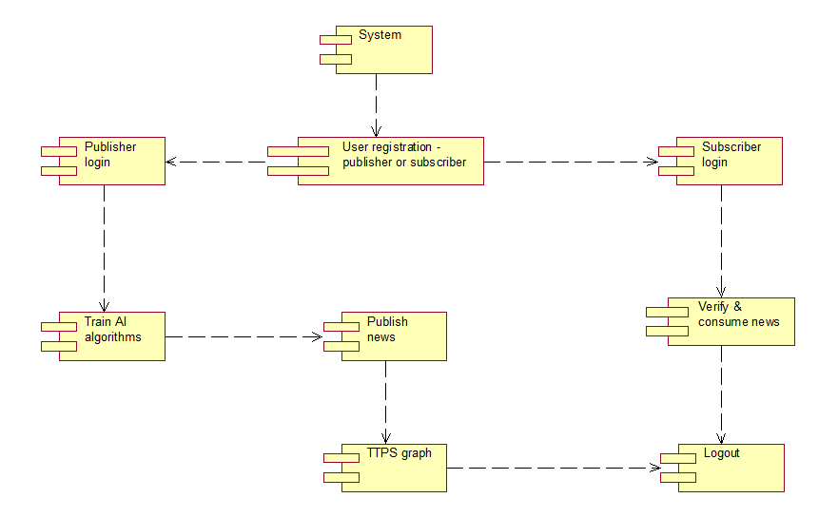
COMPONENT DIAGRAM

Slide 26
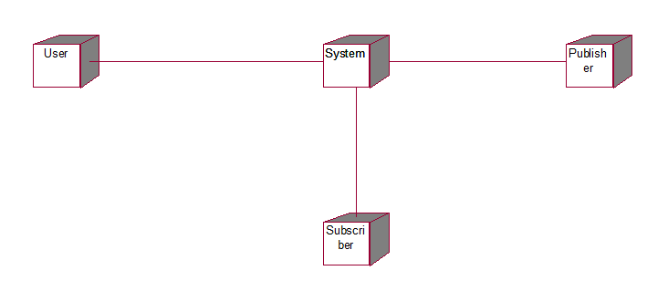
DEPLOYMENT DIAGRAM

Slide 27
Working Modules / Methodology
New User Signup:
Publisher: In this module, new users can register as publishers by providing necessary details. Once signed up, they are allowed to publish news articles and access features related to news management.
Subscriber: This section enables users to register as subscribers, granting them access to view news articles published by others on the Blockchain.
Publisher Login:
Train AI Algorithm: After logging in, publishers can train various AI algorithms (such as ANN, LSTM, Bi-directional GRU, and XGBOOST) on their dataset to improve the accuracy of fake news detection. The system displays performance metrics like accuracy, precision, recall, and F-score for each algorithm.

Slide 28
Working Modules / Methodology
Publish News: Publishers can write and submit news articles to the system. The AI will predict whether the news is real or fake before it is saved on the Blockchain, ensuring that only verified content is published.
TTPS Graph: This feature allows publishers to view a graph representing Total Transactions Per Second (TTPS), showing the performance of the Blockchain in processing news transactions over time.
Subscriber Login:
Verify and Consume News: Subscribers can log in to access the news articles stored on the Blockchain. They can view news content along with its SHA256 hash fingerprint, upload date, and the AI's prediction of the news article being either fake or real. This module ensures that subscribers can easily verify the authenticity of the news they consume.

Slide 29

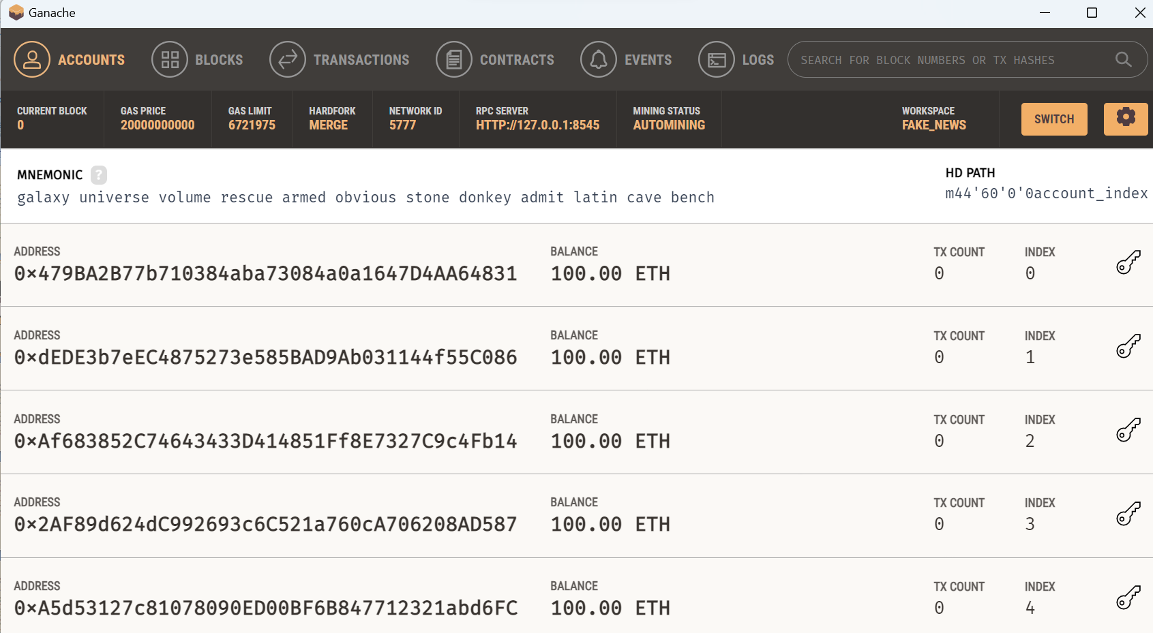
EXECUTION
Step-1
Step-2

Slide 30
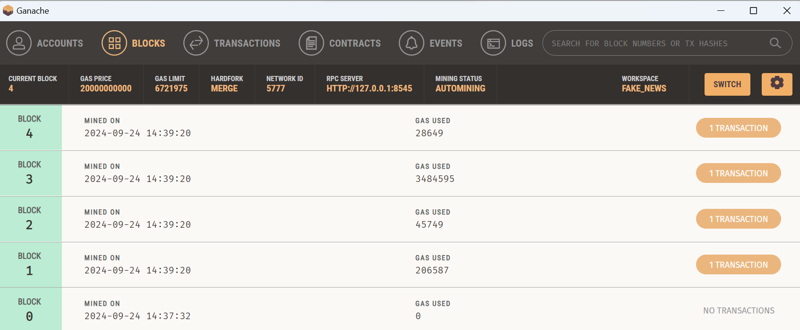
Blocks in Ganache before executing the remaining Steps

Slide 31
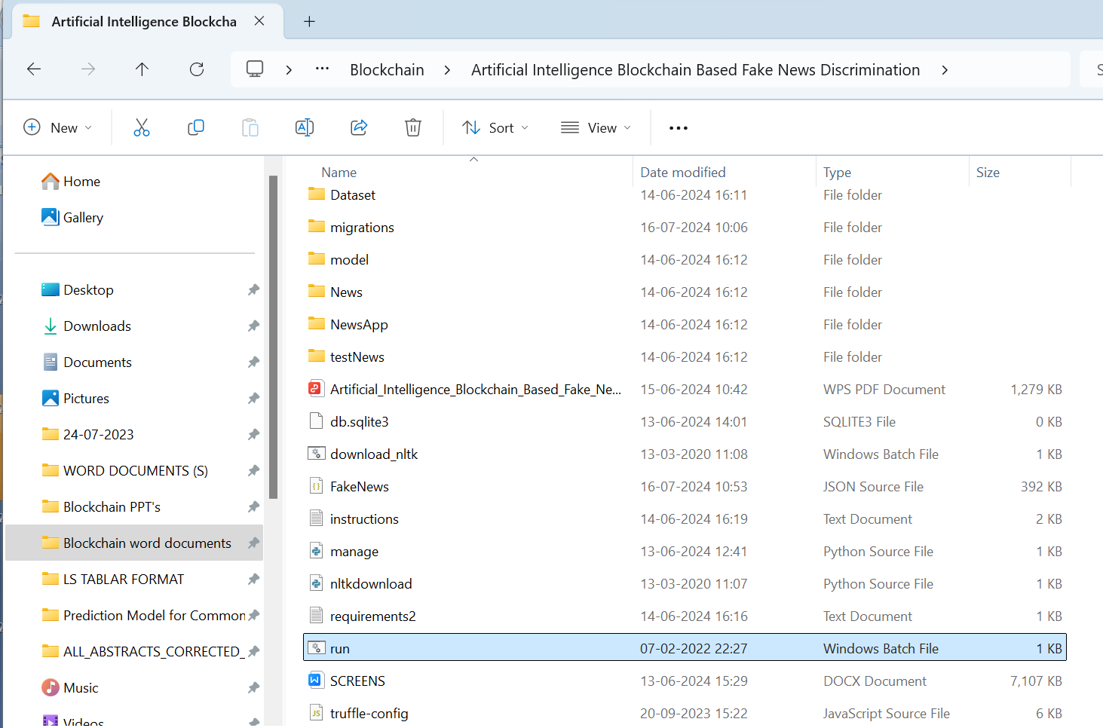
Step-3

Slide 32
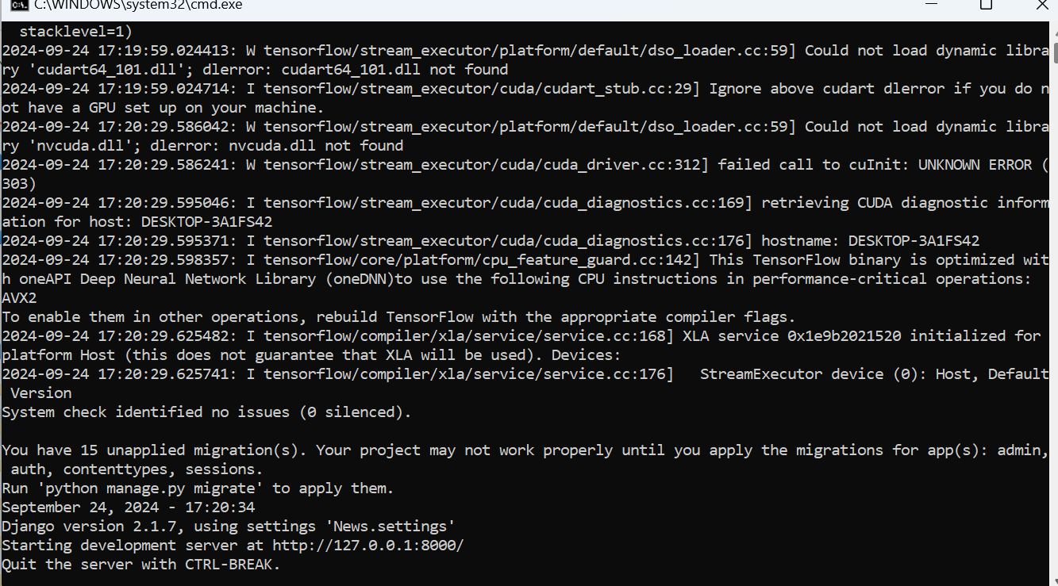
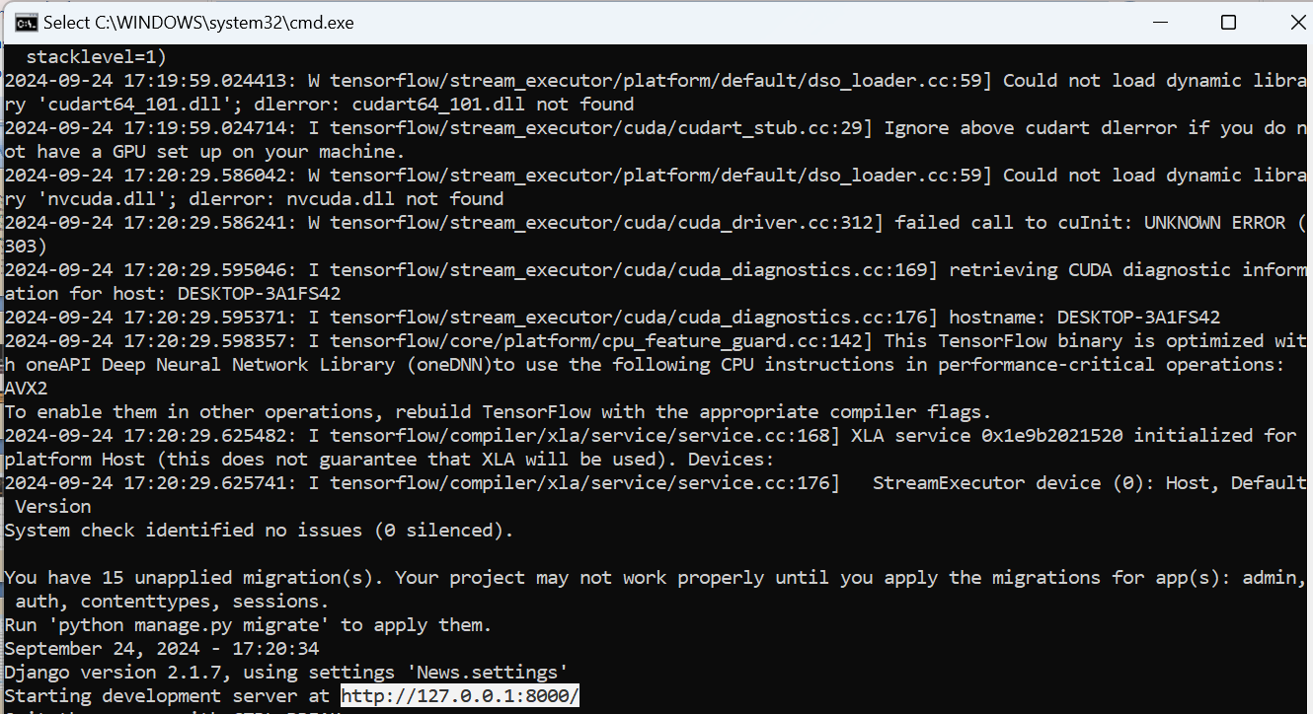
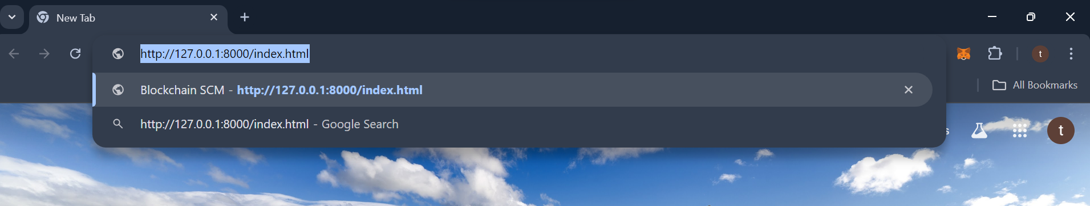
Result after step-3
Step-4
Step-5

Slide 33

Frontend

Slide 34


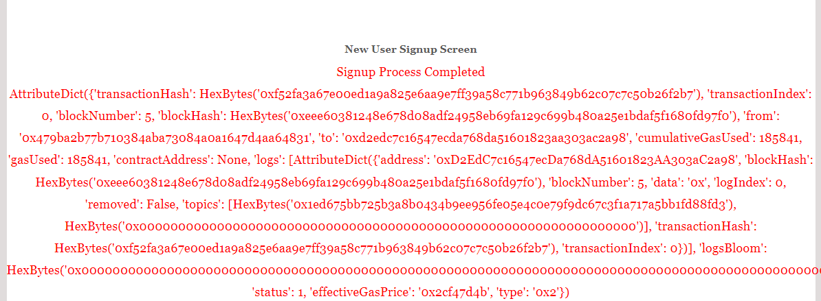
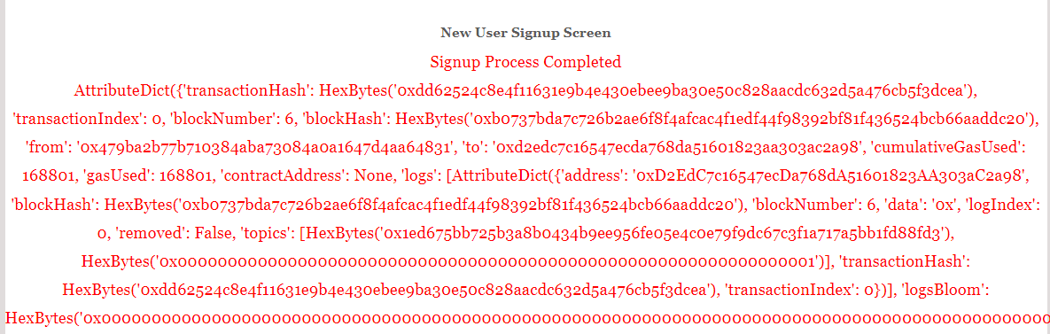
Step-7
Step-6
Result after Step-6
Result after Step-7

Slide 35


Step-8
Publisher Dashboard

Slide 36

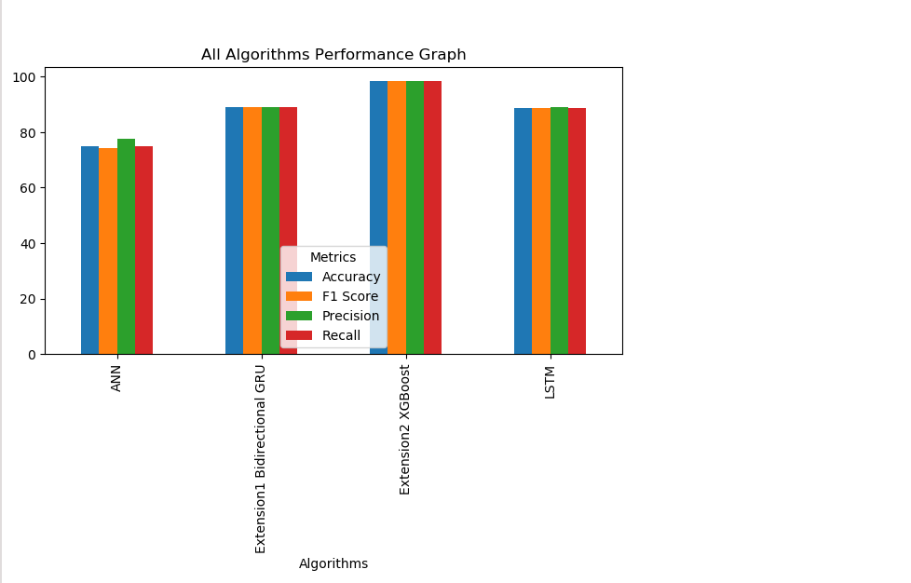
Step-9

Slide 37


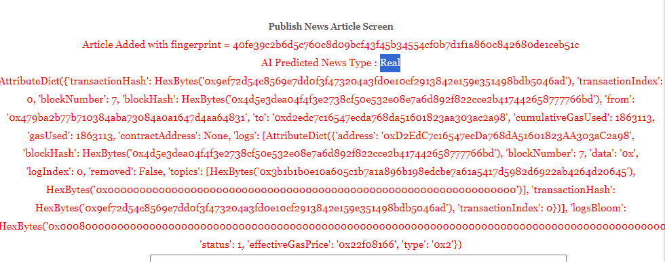
Step-10
Step-11
Result after Step-12

Slide 38

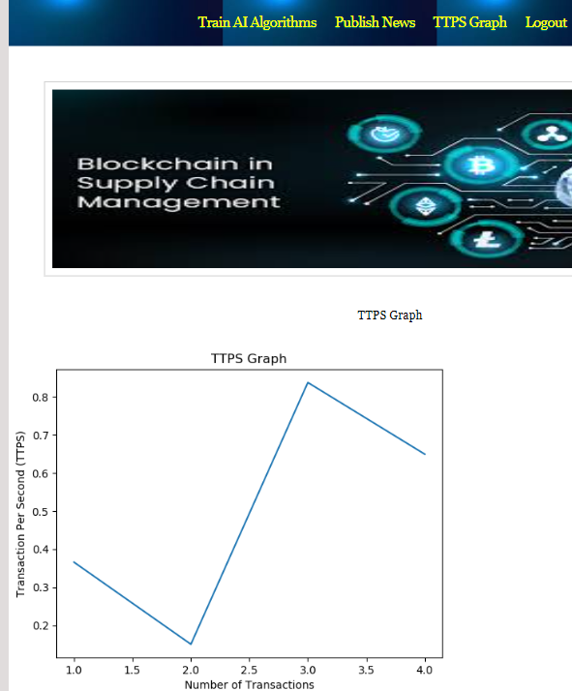
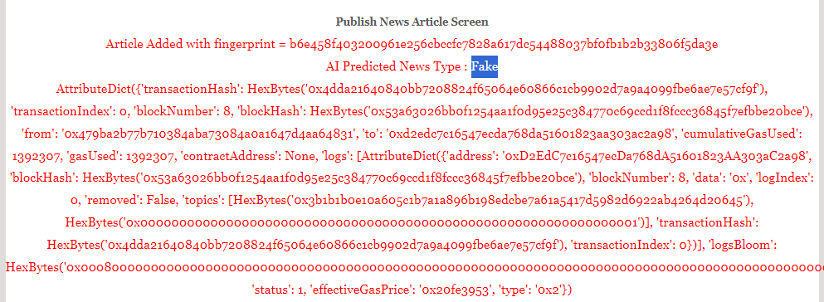
Step-13
Step-14
Result after Step-13

Slide 39


Subscriber Dashboard
Step-15

Slide 40
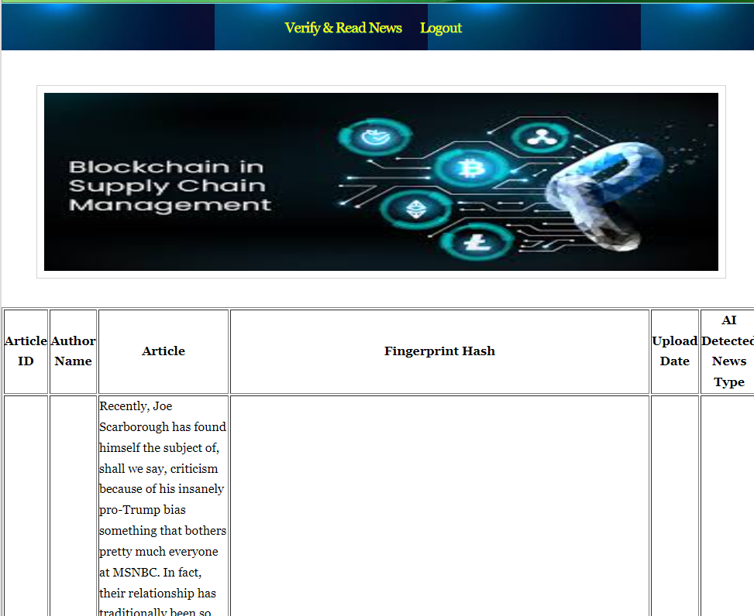
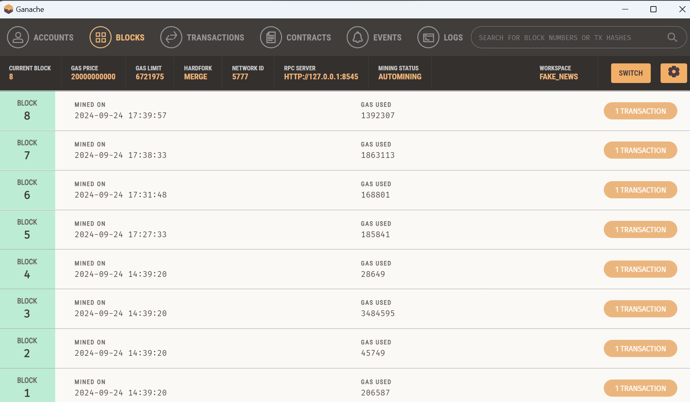
Result Blocks in blockchain after executing all the Steps
Step-16

Slide 41


Step-17
Step-18

Slide 42
CONCLUSION
The framework successfully integrates Blockchain technology and Artificial Intelligence to tackle the issue of fake news.
Blockchain technology ensures secure and tamper-proof storage, enhancing the integrity and authenticity of news articles.
The incorporation of advanced AI algorithms, automates the detection and classification of fake news, resulting in efficient verification processes.
The extension of the project advanced techniques like Bi-directional GRU and XGBOOST, significantly improved the accuracy of fake news detection.
The decentralized nature of the system fosters transparency, allowing users to easily verify the authenticity of the news content.
This project lays the groundwork for future advancements, offering a scalable and effective solution to combat misinformation in the digital age.

Slide 43
Future Scope
Adapt the system to support multiple languages, improving its effectiveness in analyzing fake news across diverse linguistic contexts.
Implement a real-time monitoring system to alert users about emerging fake news, enhancing proactive misinformation management.
Develop partnerships with news organizations and fact-checkers to create collaborative platforms for verifying news content.
Focus on initiatives that educate users about fake news and misinformation, empowering them to critically evaluate news content.

Slide 44
REFERENCES
Raza, S., Ding, C. Fake news detection based on news content and social contexts: a transformer-based approach. Int J Data Sci Anal 13, 335–362 (2022).
Yang, S., Shu, K., Wang, S., Gu, R., Wu, F., & Liu, H. (2019). Unsupervised Fake News Detection on Social Media: A Generative Approach. Proceedings of the AAAI Conference on Artificial Intelligence, 33(01), 5644-5651.
Nguyen, V., Sugiyama, K., Nakov, P., & Kan, M. (2020). FANG: Leveraging Social Context for Fake News Detection Using Graph Representation. Proceedings of the 29th ACM International Conference on Information & Knowledge Management.
Ruchansky, Natali et al. “CSI: A Hybrid Deep Model for Fake News Detection.” Proceedings of the 2017 ACM on Conference on Information and Knowledge Management (2017): n. pag.
Yang Liu and Yi-Fang Brook Wu. 2018. Early detection of fake news on social media through propagation path classification with recurrent and convolutional networks. In Proceedings of the Thirty-Second AAAI Conference on Artificial Intelligence and Thirtieth Innovative Applications of Artificial Intelligence Conference and Eighth AAAI Symposium on Educational Advances in Artificial Intelligence (AAAI'18/IAAI'18/EAAI'18). AAAI Press, Article 44, 354–361.

